Slide 1
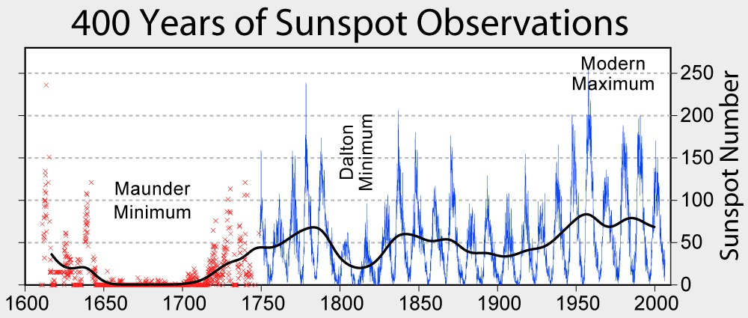
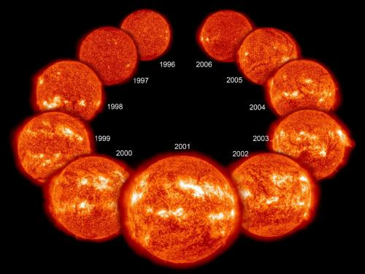
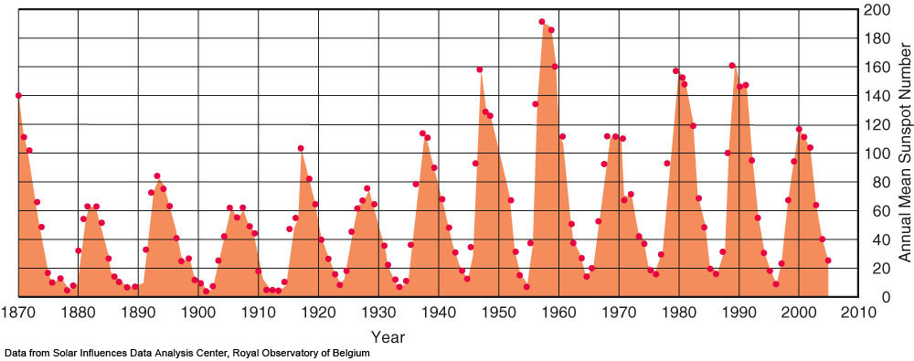
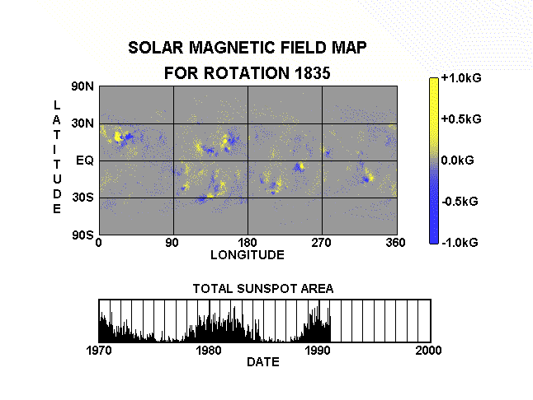
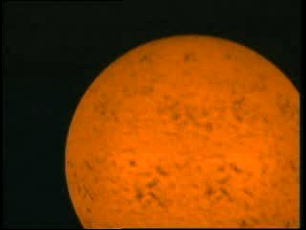
5.2b.1 Solar Dynamo: winding magnetic field and sunspot numbers
Little Ice Age
Cooling
© Gerard Williger 2023 U Louisville
150 yrs
Notes:
Figure 10.18: The 11-year sunspot cycle is but one manifestation of the solar-activity cycle. (Data from Solar Influences Data Analysis Center, Royal Observatory of Belgium)

Slide 2
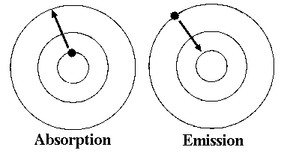
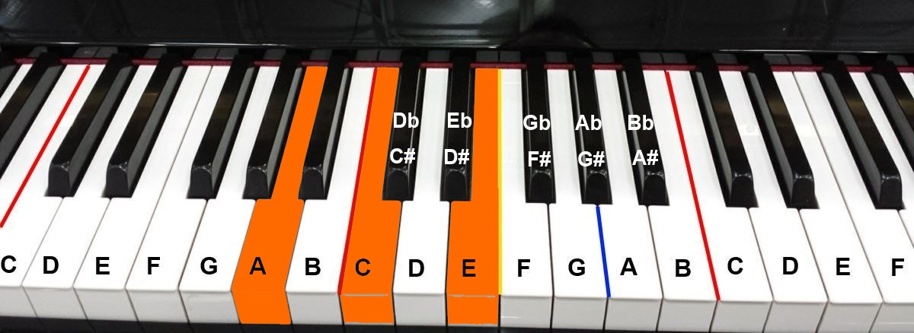
Key Concept: Atoms absorb/emit light
© Gerard Williger 2023 U Louisville
Electrons in atoms have discrete energy levels
Electrons moving UP - absorb photons of certain wavelengths
Electrons moving DOWN - emit photons of certain wavelengths
Similar to of sets of notes on a piano

Slide 3
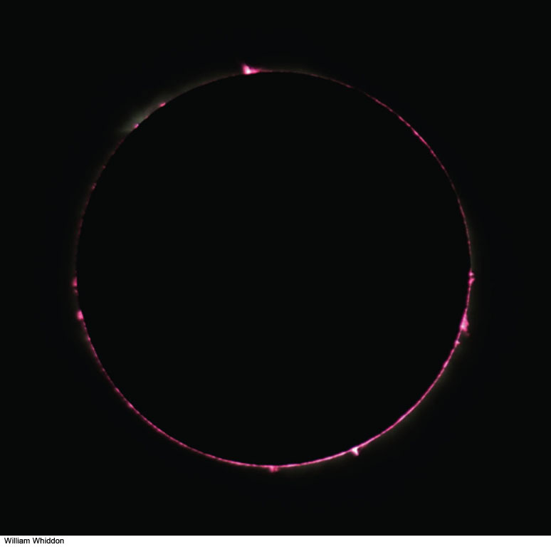
© Gerard Williger 2023 U Louisville
Chromosphere
Bright+opaque in red "hydrogen-alpha light” (emission lines)
Above photosphere
Few x1000 km deep (= thin layer!)
T~7,000-15,000K = 13,000-27,000F
Led to discovery of helium
Well-observed during eclipses
1.8’ VIDEO FYI: emission, absorption and continuum spectra
Notes:
Figure 10.4a: The chromosphere of the Sun, photographed during the total solar eclipse of April 8, 2005. Notice how pink it looks.
William Whiddon

Slide 4
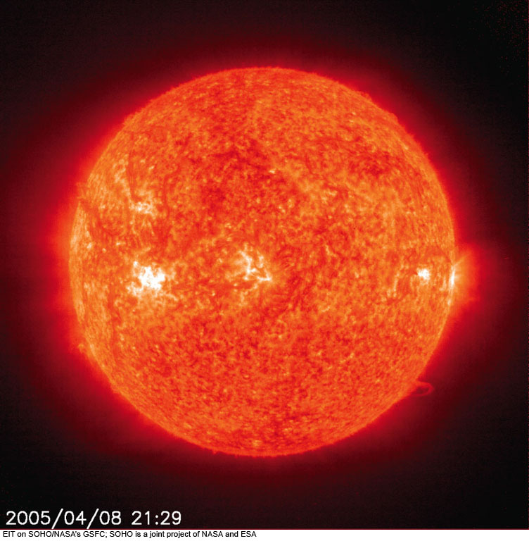
Chromosphere
© Gerard Williger 2023 U Louisville
Photographed in light of singly ionized helium
Sunspot in photosphere, bright spot in chromosphere
Notes:
Figure 10.9: A set of images taken almost simultaneously through the four filters of the Extreme-ultraviolet Imaging Telescope (EIT) on the Solar and Heliospheric Observatory (SOHO) in space. These images were taken at the same time a total solar eclipse was observed, at about Universal Time 2100 on April 8, 2005.
(a) Ionized helium gas at a temperature of about 60,000 K, with a small contribution from ionized silicon. This wavelength shows the chromosphere.
EIT on SOHO/NASA’s GSFC; SOHO is a joint project of NASA and ESA

Slide 5
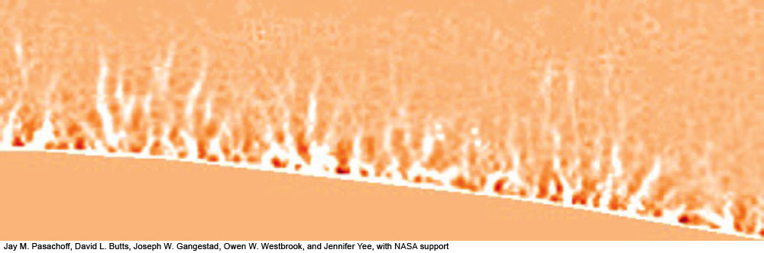
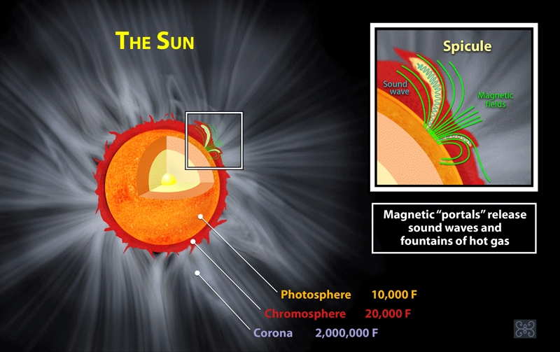
Spicules In Chromosphere
Spicules in Chromosphere
700km wide x 7000 km tall (same size as granules)
Jets ejected into chromosphere from photosphere
Last for 5-15 minutes
Half million at any time
Transition region
© Gerard Williger 2023 U Louisville
Notes:
Figure 10.8b: A high-resolution image of the Sun, showing spicules, taken by one of the authors (J.M.P.) and his students with the Swedish Solar Telescope in the Canary Islands.
Jay M. Pasachoff, David L. Butts, Joseph W. Gangestad, Owen W. Westbrook, and Jennifer Yee, with NASA support

Slide 6
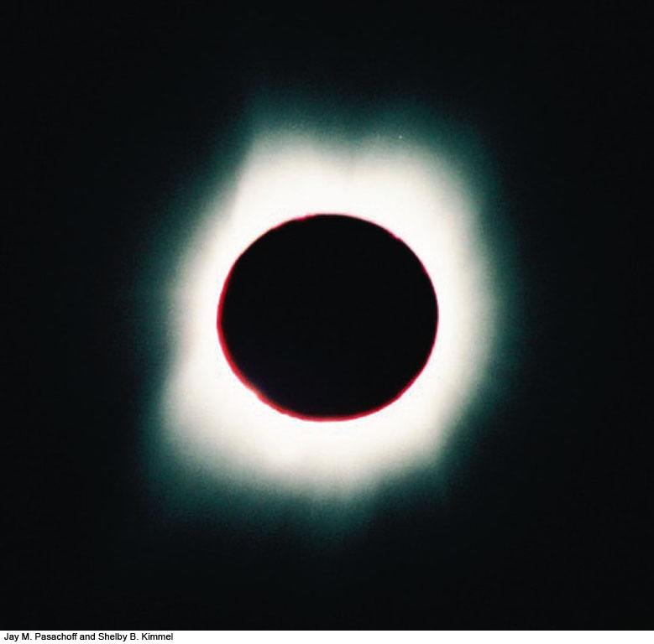
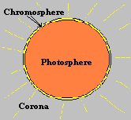
5.2b.2 Corona: Sun’s Atmosphere
© Gerard Williger 2023 U Louisville
Inner Corona
Very hot: 1-2 million Kelvin = 2-4 million F
Very low density: 1/10 billionth of air → FAINT (normally only visible from Earth during eclipses)
Heated by magnetic fields from below
Magnetic fields “crack the whip” in ionized gas
Low density → gets hot by absorbing even a little energy
Corona is powerful X-ray source
3.5’ video – coronal heating
Corona expands throughout solar system
→ produces solar wind -- 0.01 trillionth of sun’s mass/yr
15” Audio: sound of solar wind, from Parker Solar Probe

Slide 7
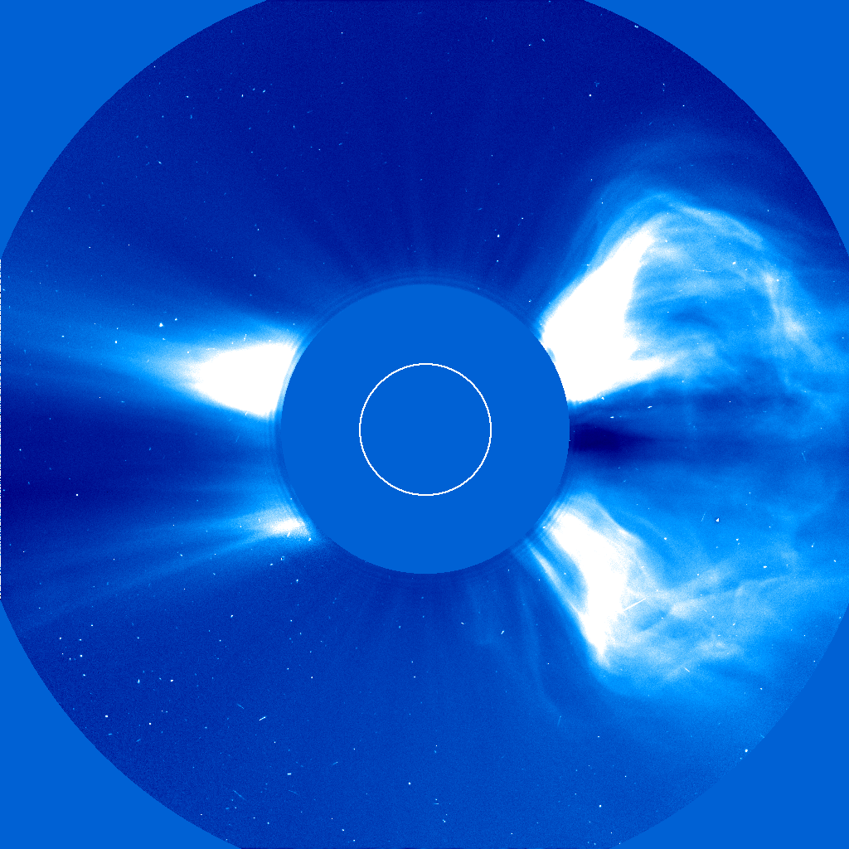
Form of Corona - VARIABLE
© Gerard Williger 2023 U Louisville
Holes: over poles, other places
Streamers: over equator
Loops of gas: follow magnetic fields
Studied during eclipses or by satellites with a coronagraph
blocks out photosphere, lets us observe faint corona
Coronal Mass Ejections (CMEs)
Explosions in corona, release particles into solar wind; some knock out power/satellites on Earth, ~1/day

Slide 8
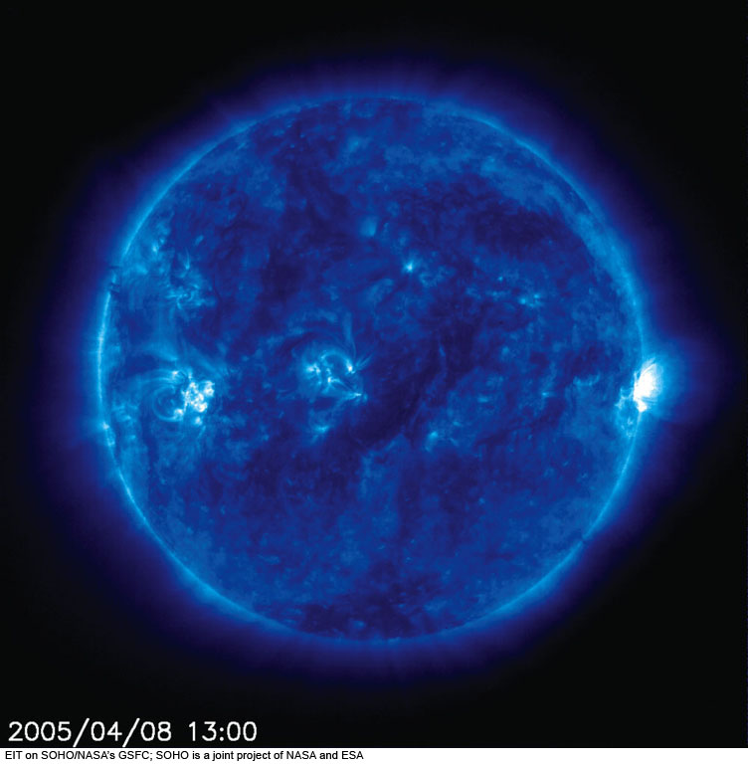
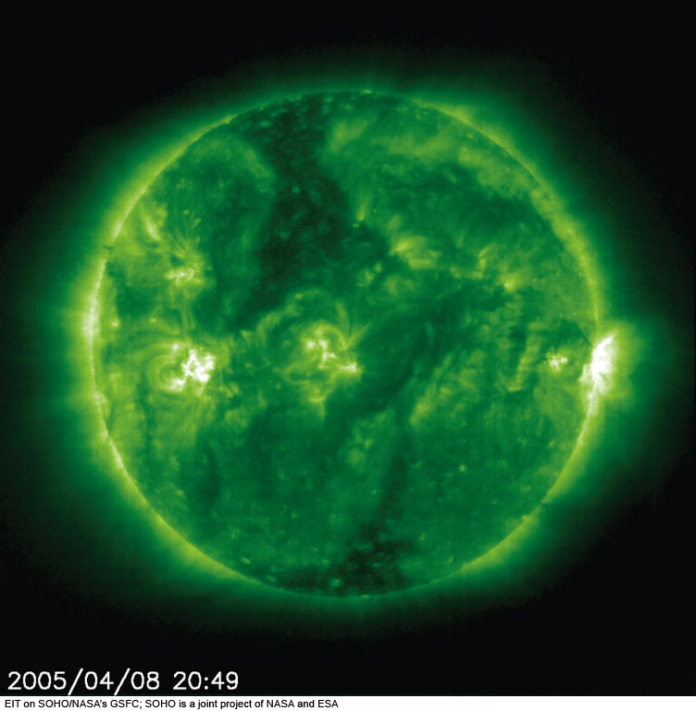
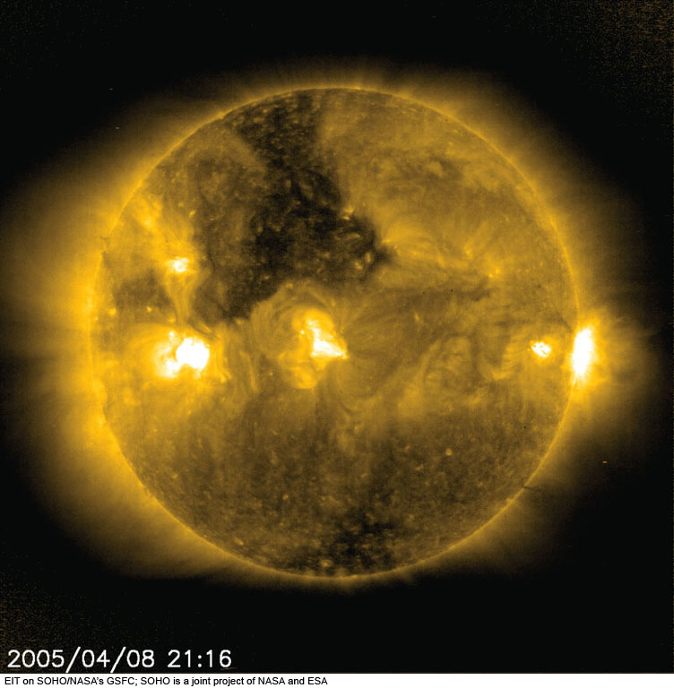
Corona at different temperatures and X-ray wavelengths
© Gerard Williger 2023 U Louisville
Corona at 1 million K (ionized Fe emission)
Corona at 1.5 million K (ionized Fe emission)
Corona at 2 million K (ionized Fe emission)
Notes:
Figure 10.9: A set of images taken almost simultaneously through the four filters of the Extreme-ultraviolet Imaging Telescope (EIT) on the Solar and Heliospheric Observatory (SOHO) in space. These images were taken at the same time a total solar eclipse was observed, at about Universal Time 2100 on April 8, 2005.
(b) Ionized iron at a temperature of about 1,000,000 K.
EIT on SOHO/NASA’s GSFC; SOHO is a joint project of NASA and ESA

Slide 9
5.2c Flares & Coronal Mass Ejections: “Space Weather”
© Gerard Williger 2023 U Louisville
Flare: magnetically driven release of mostly photons (X-rays etc.), takes 8 minutes to reach Earth
CME: magnetically driven release of mostly charged particles, takes 2-3 days to reach Earth
They can start together!
-- Can knock out satellites and power grids
1.7’ video FYI

Slide 10
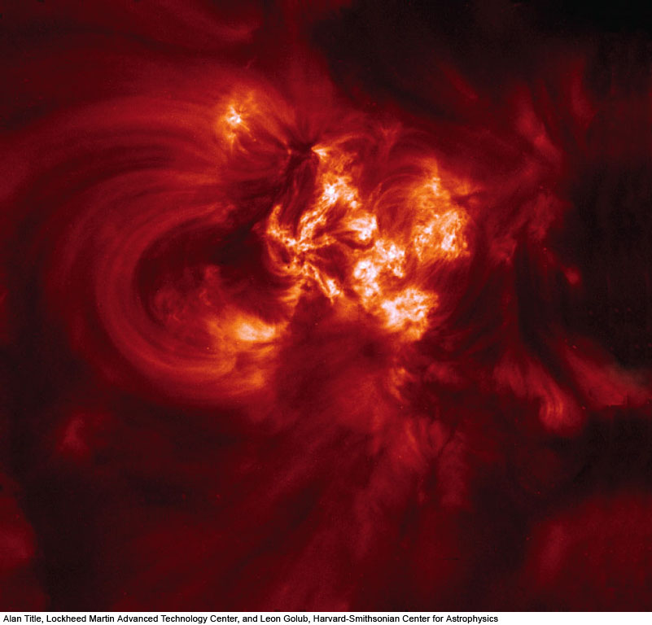
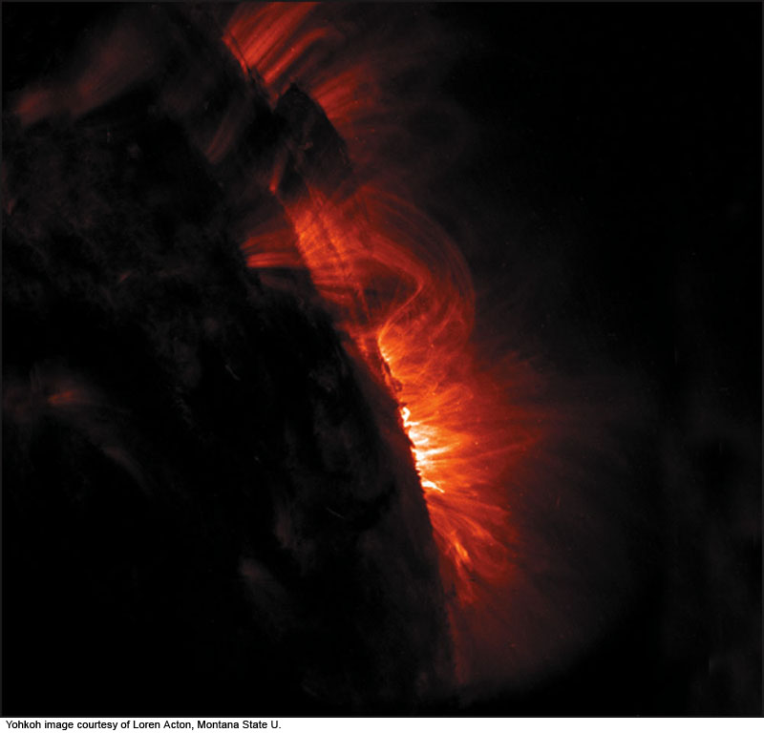
From TRACE satellite (Transition Region And Coronal Explorer), ultraviolet wavelengths
© Gerard Williger 2023 U Louisville
Small Coronal Loops
Giant Coronal Loops
From TRACE satellite, ultraviolet wavelengths)
Notes:
Figure 10.15: An ultraviolet image, taken from space on the day of the April 8, 2005, total solar eclipse, shows small coronal loops. The image was made with the TRACE spacecraft. The expeditions of one of the authors (J.M.P.) observed such loops from the ground during the eclipse, with lower spatial resolution but higher time resolution.
Yohkoh image courtesy of Loren Acton, Montana State U.

Slide 11
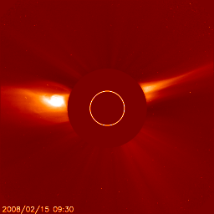
Coronal activity Feb 2008 SOHO (uses coronagraph) – space.com
© Gerard Williger 2023 U Louisville

Slide 12
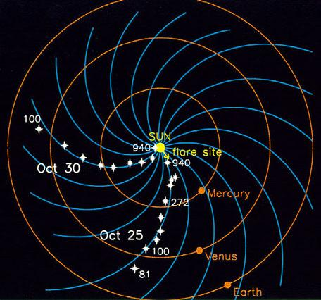
a
Corona expands throughout solar system, follows magnetic field lines, → twists up due to solar rotation, becomes
solar wind
MASS LOSS: ~10⁻¹⁴ Msun/yr
© Gerard Williger 2023 U Louisville
Twisted Solar Magnetic Field

Slide 13
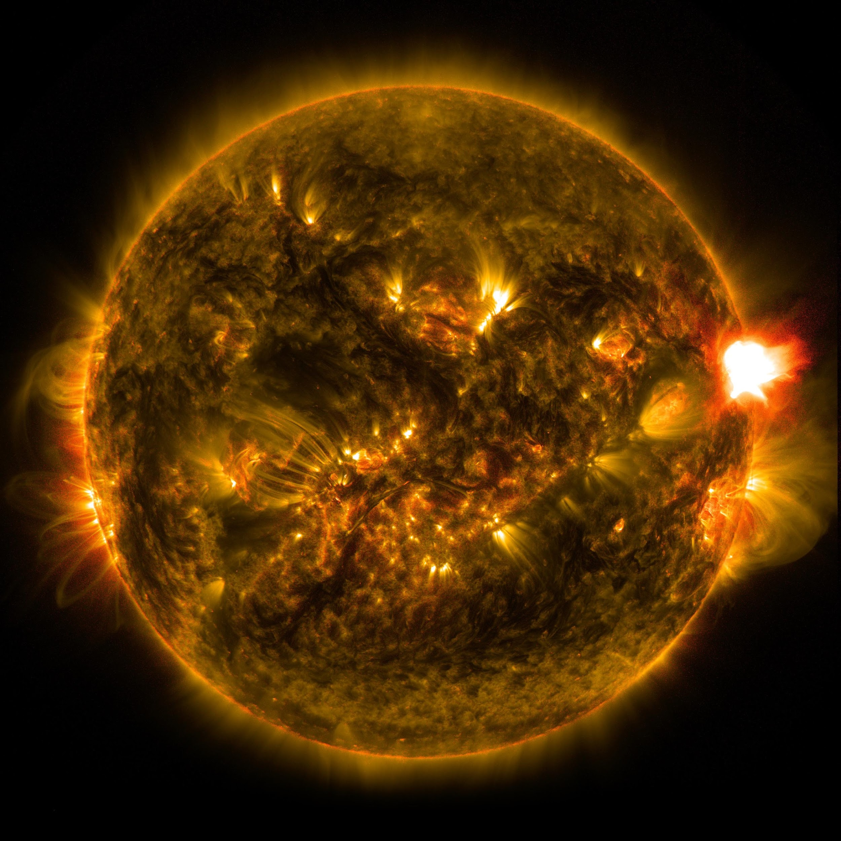
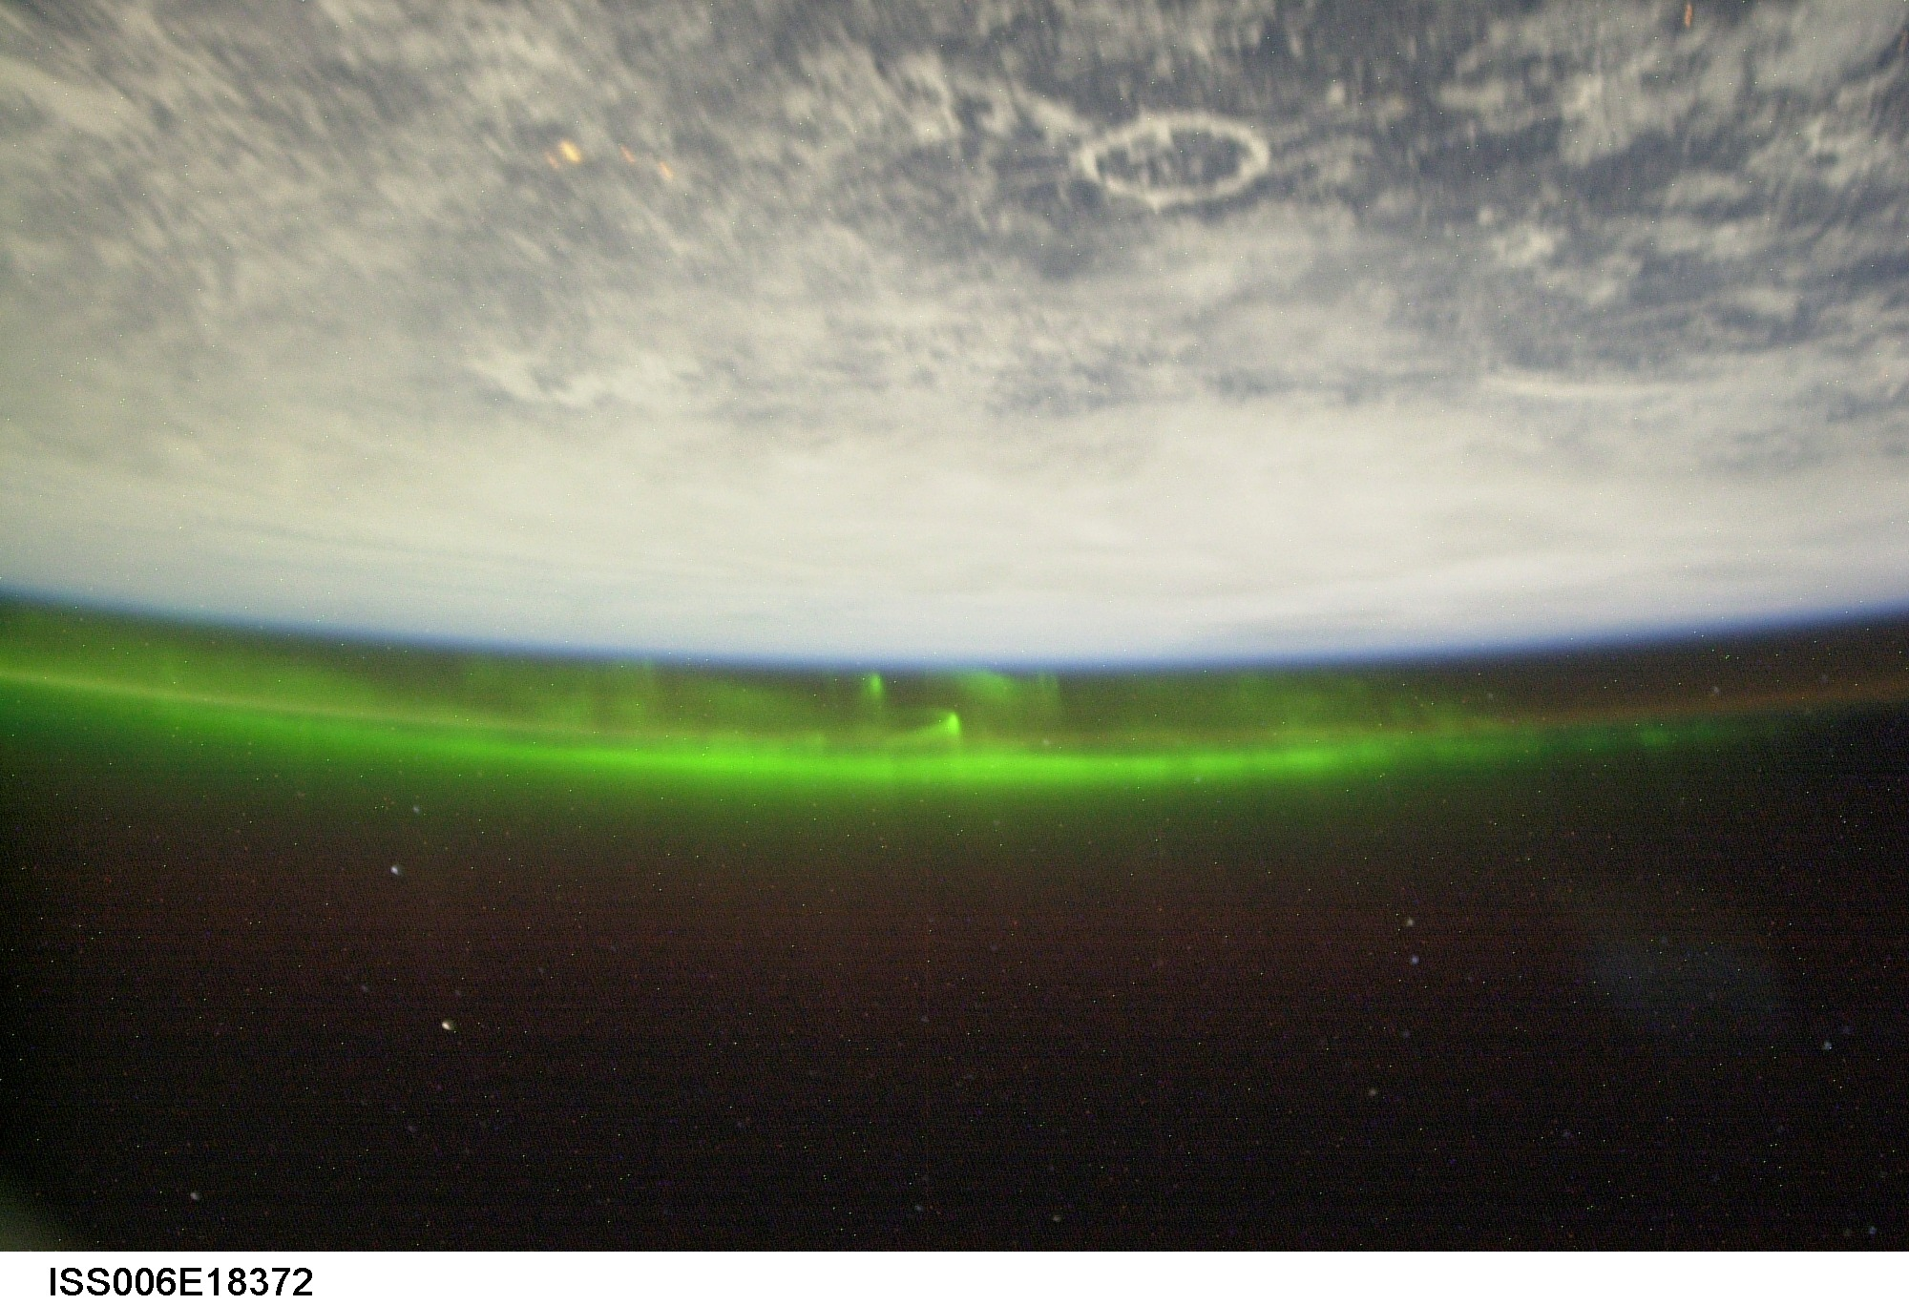
Solar Weather
© Gerard Williger 2023 U Louisville
Flares: giant/bright eruptions of radiation, arising in `active regions' (sunspots etc. – anything caused by magnetic disturbances) – make auroras
Can knock out power/satellites (Quebec Blackout 1989); cause big aurorae; dangerous to astronauts
Cause unknown! (Hinode satellite to study them)
Probably related to magnetic reconnection: twisted mag field lines `snap’ and come together again
2.4’ VIDEO – 1989 event, CBC
Aurora
FYI: 2012 IEEE article
7.5’ VIDEO , IEEE Spectrum

Slide 14
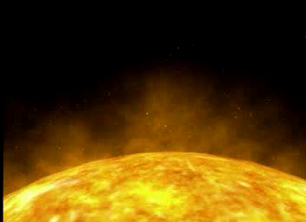
Coronal Mass Ejections (CMEs)
© Gerard Williger 2023 U Louisville
Giant ejections of material, maybe related to flares, caused by magnetic disturbances, hits Earth’s magnetosphere, causes aurorae

Slide 15
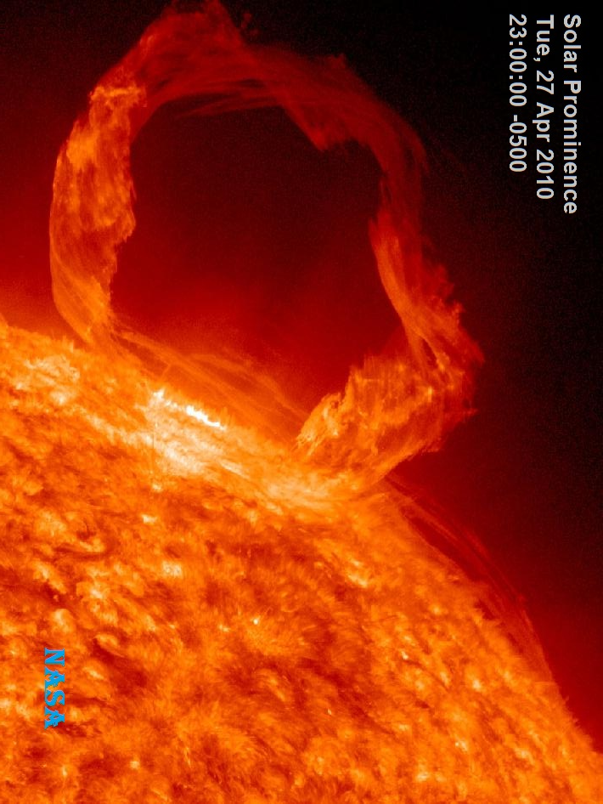
5.2d Filaments & Prominences
© Gerard Williger 2023 U Louisville
Elongated thread of COOL gas in chromosphere, see in Hα at λ=6563Ǻ (Angstroms):
Against Sun’s disk: DARK Filaments 10⁵ km across (7% of Sun’s diameter)
Against Sun’s limb (edge): BRIGHT Prominences: Ejected loops of chromospheric material – glow at Hα wavelength
Held in place by magnetic fields

Slide 16
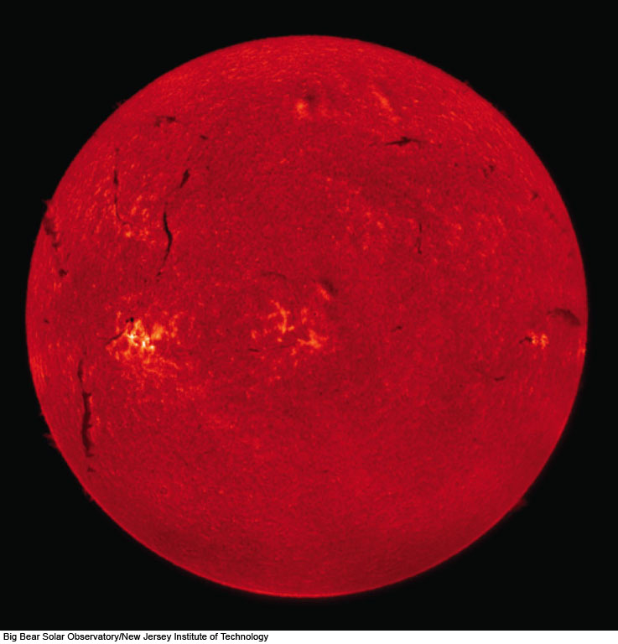
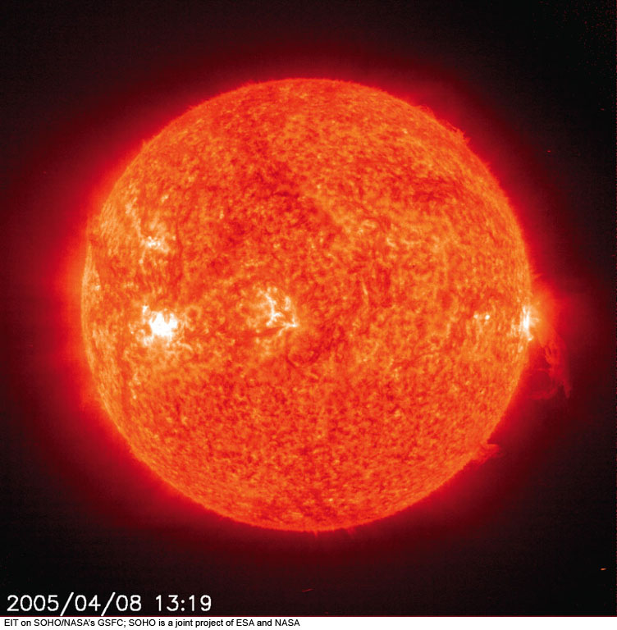
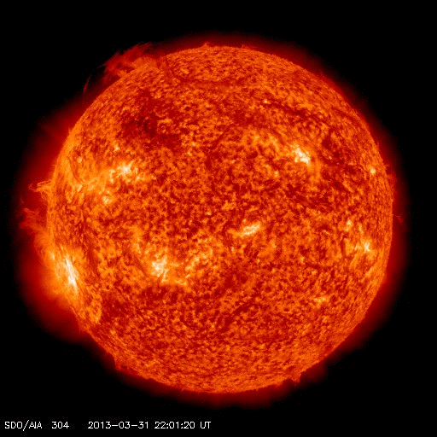
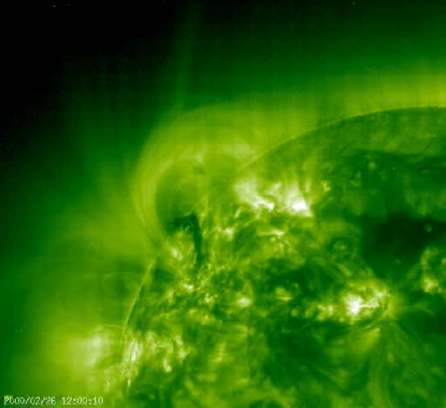
Filaments
Prominence
Polar crown filament, shows connection to prominence, Solar Dynamics Observatory 2013 Mar 31 – Apr 1
© Gerard Williger 2023 U Louisville
Notes:
Figure 10.8a: The Sun, photographed in hydrogen radiation, shows bright areas called plages and dark filaments around the many sunspot regions. We see an image from April 8, 2005, the day of a total eclipse.
Big Bear Solar Observatory/New Jersey Institute of Technology

Slide 17
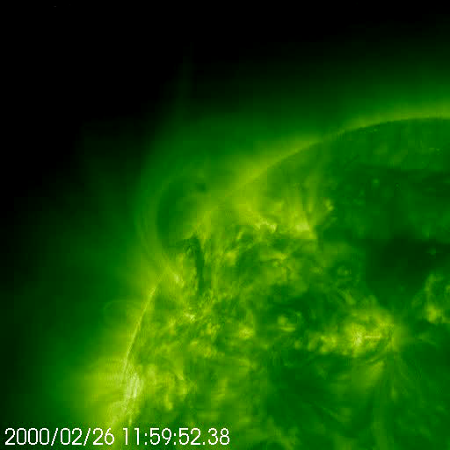
Prominence Eruption
© Gerard Williger 2023 U Louisville
1.1’ video - prominences
Notes:
Figure 10.8a: The Sun, photographed in hydrogen radiation, shows bright areas called plages and dark filaments around the many sunspot regions. We see an image from April 8, 2005, the day of a total eclipse.
Big Bear Solar Observatory/New Jersey Institute of Technology

Slide 18
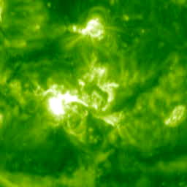
Solar Flare and CME
© Gerard Williger 2023 U Louisville
Coronal Mass Ejection (CME): Giant ejections of material, maybe related to flares, caused by magnetic disturbances, hits Earth’s magnetosphere, causes aurorae

Slide 19
Summary
© Gerard Williger 2023 U Louisville
Solar structure/layers
How we study Sun (at various wavelengths, with coronagraphs, helioseismology with Doppler shifts)
Phenomena generated by magnetic fields
Eclipses help us observe chromosphere + corona

